Slide 1
Taking Notes, Writing and Speaking
Chapter 6

Slide 2
These Are Related:
MEMORY
READING
NOTES

Slide 3

Why take notes?

Slide 4
Why take notes?
To remember

Slide 5
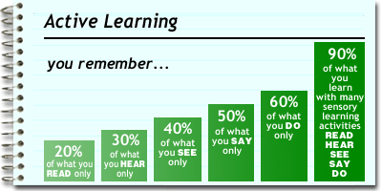
Be an active learner to remember as much as possible.

Slide 6


Over 50% of what we hear is lost in the first 20 minutes to an hour.

Slide 7

If your mind wanders, you can be
here now by taking notes.

Slide 8

Tips for taking notes
Be physically alert

Slide 9

Tips
Develop a positive attitude. Convince yourself that the speaker has something valuable to say.

Slide 10
Tips
Distinguish between listening and hearing.

Slide 11

Hearing is done with the ears.

Slide 12
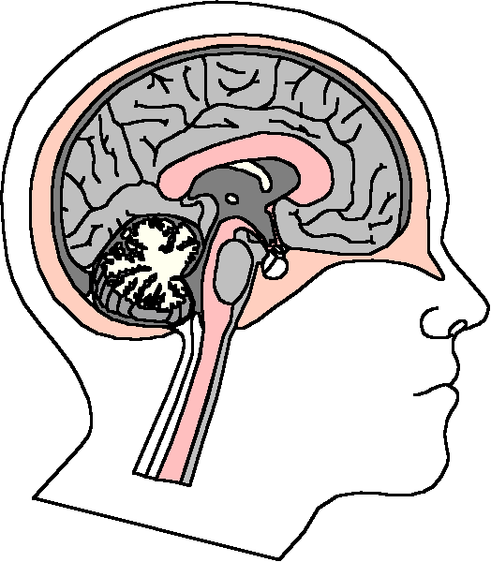
Listening is done with the mind.

Slide 13

Tips
STAY AWAKE!
Ask yourself questions
  Why is she saying that?
  What does he mean?
  What is the main point?

Slide 14

Tips
Take notes
The act of writing
keeps you physically
and mentally alert

Slide 15

Be open to different viewpoints and new ideas.

Slide 16

Prepare for note taking.

Slide 17
Have the proper materials.
Three ring binder
Notebook paper
Pen
Highlighter

Slide 18
Review the calendar and syllabus
What topic is being discussed?

Slide 19

Read the text
Find the main ideas
Be familiar with
the topic

Slide 20
What to write down
Focus on the main ideas.
Write supporting details as you have time.
Watch for verbal signals.

Slide 21

Signal words point the way.

Slide 22
Example Words
To illustrate
For example
For instance
Here comes an example. Write it down.

Slide 23
Addition Words
Here comes another main idea. Write it down too.
In addition
Also
Furthermore

Slide 24
Enumeration Words
The five steps
First, second, third
Next
Here comes a list. Organize your notes and write down the items in the list.

Slide 25
Time Words
Before, after
Formerly
Subsequently
Prior
Meanwhile
Hmm! Here comes a time relationship. What comes first and what happens next.

Slide 26
Cause and Effect Words
Therefore
As a result
If. . . .then
Here comes a cause and effect. Write the labels “cause” and “effect” in your notes and get these ideas in your notes.

Slide 27
Definition Words
In other words
It simply means
That is
In essence
Here comes a definition. Label it “def” and write down the definition. Test questions are often based on definitions.

Slide 28
Swivel Words
However
Nevertheless
Yes, but
Still
Here comes an exception or qualifying remark. Put this in your notes.

Slide 29
Compare and Contrast
Similarly
Likewise
In contrast
Write the similarities and differences in your notes.

Slide 30
Summary Words
In conclusion
To sum up
In a nutshell
Great! This is the end. I’ll try to write the summary word for word to make sure I have the most important ideas.

Slide 31
Test Words
This is important.
Remember this.
You’ll see this again
You might want to study this for the test.
This will be on the test. Make sure to know this.

Slide 32
Nonverbal Signals
Visually presented material
Handouts
Write down
whatever is
written on the
board

Slide 33



Note Taking Systems

Slide 34
The Cornell Format
2 1/2 inches
6 inches
RECALL
COLUMN
TAKE NOTES HERE
INDENT FOR MINOR
POINTS
MAJOR POINTS
QUESTIONS
OUTLINE

Slide 35
Practice: Taking Notes in the Cornell Format

Slide 36
Create a Mind Map
Check
Syllabus
Read
Review
Be here now
Note taking
Develop An
Interest
Record

Slide 37
Taking Notes in Math
Pre-read the chapter before the lecture so that you can become familiar with the concepts.
As you read, write some questions in the margin so you can ask them in class if needed.

Slide 38
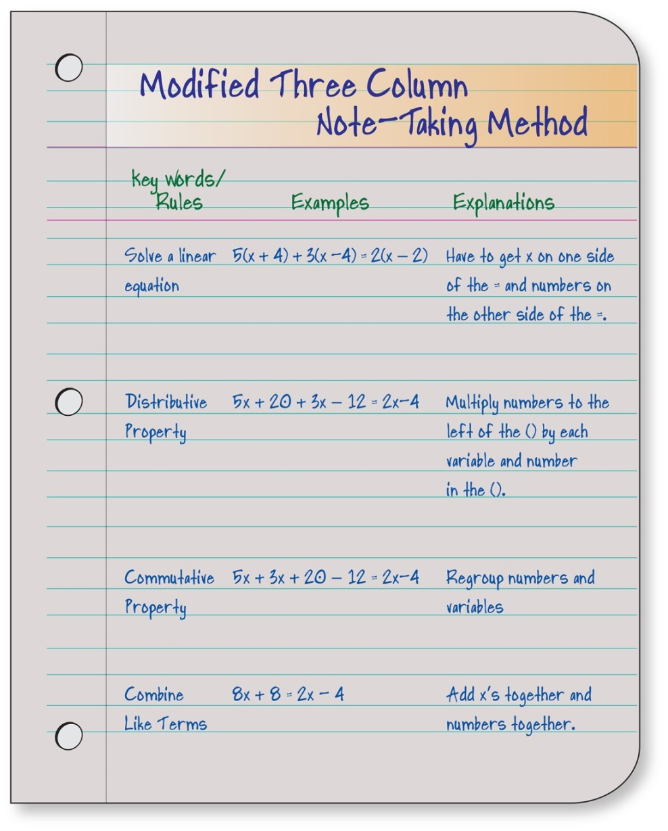
Three Column Note-Taking Method

Slide 39
Practice: Taking Notes with a Mind Map.

Slide 40
Research notes
Notes for writing papers and speeches
Use 3x5 cards
Source cards
Information cards
Use your own words
3x5 card

Slide 41

Review Your Notes

Slide 42

Remember that it is most effective to review within 20 minutes.

Slide 43

How to Review

Slide 44
Highlight or underline the main points. Fill in missing details.

Slide 45
If using the Cornell Format, use the recall column to test yourself.

Slide 46
Group Activity:
A Case Study

Slide 47
Assignment:
Note Taking Checklist
Evaluate Your Note Taking
Skills

Slide 49
Power Writing
Prepare
Organize
Write
Edit
Revise

Slide 50
Prepare

Slide 51
Plan Your Time
Avoid stress by planning ahead.
Allow time for life’s emergencies and computer problems.

Slide 52
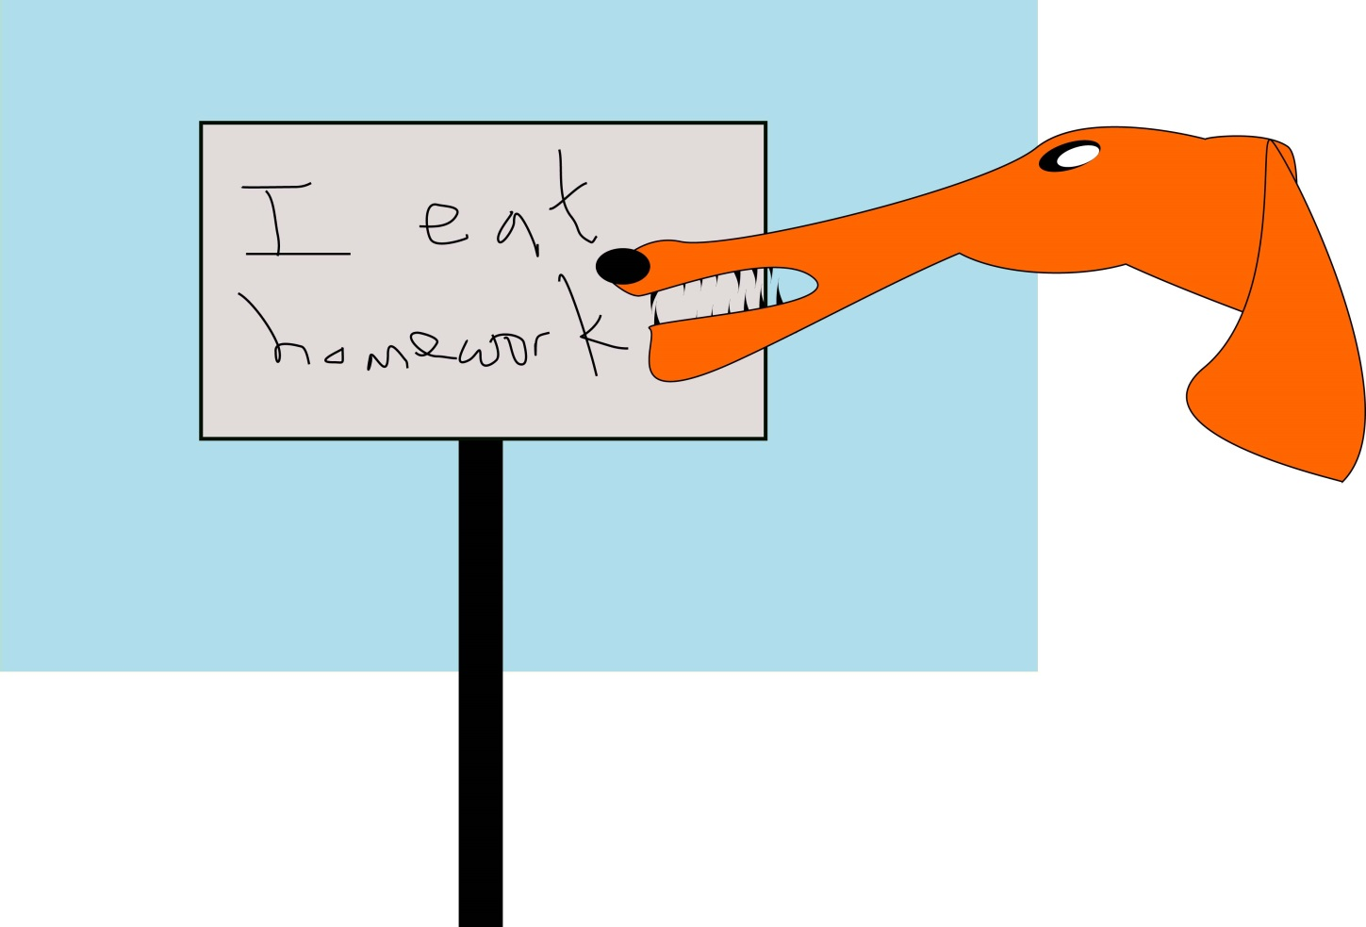
Professors have heard all the excuses!

Slide 53
Find a Space and Time

Slide 54

Choose a General Topic

Slide 55
Gather Information

Slide 56

Write a Thesis Statement
The key idea
  What is the most important idea?
  What question would I like to ask about it?
  What is my answer?

Slide 57

Organize
List topics
Arrange in a logical order

Slide 58
Write

Slide 59

Get Started
Write freely.
Use brainstorming.
if you are stuck.
Write the first sentence.
Write the introduction.
Write a first draft.
Break it into small parts.
Beware of procrastination.

Slide 60
Exercise: Free Writing

Slide 61
Writing a paper is like climbing a mountain. What small steps can you take to get started?

Slide 62



Save Your Work
On your hard drive
On a flash drive
A written copy

Slide 63
The Introduction
Contains the thesis statement
Foundation for the paper
Contains interesting points that motivate the reader to read your paper

Slide 64
The Body of the Paper
Good writing is clear thinking.
Use plain and understandable language.
Provide explanation and examples.

Slide 65

Beware of Plagiarism
Copying the work of others without giving them credit

Slide 66
Avoid Plagiarism by:
Using quotations and providing a reference
Thinking about the main ideas and then looking away and writing them in your own words

Slide 67
Write a Conclusion
Summarizes topics
Answers question posed in the thesis statement
Make it interesting and powerful

Slide 68

Include References
Author
Title of book
Publisher of book
City where the book was published
The publication date
The page number

Slide 69



Use an Appropriate Style
APA
Chicago Style
MLA

Slide 70
Example of APA Style:
Fralick, M. College and career success, seventh ed., Dubuque: Kendall/Hunt Publishing Company, 2016, p. 99.

Slide 71
Write your first draft and put it away for awhile. Why?

Slide 72

Edit and Revise
Read it. Does it make sense?
Check grammar and spelling.
Be courageous and select the best.
Check for biased language.

Slide 73
Biased Language Examples
Policeman
Chairman
Fireman
Mailman
Mankind
Lady
Police Officer
Chair
Fire Fighter
Mail Carrier
Humanity
Woman

Slide 74
Prepare the Final Copy
Double space
Font of 10 or l2
One inch margins on sides
Three inch top margin on first page
Don’t forget Bibliography or Works Cited
Number your pages

Slide 75
The Bibliography or Works Cited
Title of Publication
Author
Publisher
Date
Page number
See text for sample

Slide 76
Term Paper Exercise
I am assigning a term paper that is due in eight weeks. You have to read 4 books, 3 magazines, and view one film. Please give me a detailed plan of how you will complete this assignment using the POWER strategy explained in the chapter.

Slide 77

Making An Oral Presentation

Slide 78

Relax!

Slide 79

Some Relaxation Techniques
Admit you are anxious.
You do not have to be perfect.
Take deep breaths and focus on your breathing.
Use positive self-talk.

Slide 80
Parts of a Speech
The Introduction
The Main Body
The Conclusion

Slide 81
Making a Speech
Practice your speech until you feel comfortable.
Review the set-up.
Deliver the speech.
  Dress appropriately and comfortably.
  Remember to smile and make eye contact.
  Don’t forget your sense of humor.

Slide 82

Make a Speech
Take an item out of your purse or wallet. Make a 30 second speech about that item.
(No cell phone, keys, or credit cards)
Include: Intro
Body
Conclusion

Slide 83
The College Success Web site has many resources on making a speech:
Toast Masters
Virtual Assistant
Examples of Best Speeches in History
Public Speaking Web Site
www.collegesuccess1.com

Slide 84
Keys to Success:
Be Selective

Slide 85
How to be selective?

Slide 86
If you focus on the details first, you will get lost.

Slide 87
Grouping the details under general ideas will help you to remember them.

Slide 88
It’s Like Putting a Puzzle Together
What does the picture look like?
Then put the pieces together

Slide 89
To Be Selective
Start with the general idea.
Then focus on the details.

Slide 90
The Essence of Genius is Knowing What to Overlook.
William James

Slide 91
To Get the General Idea:
Be a Genius
Survey the chapter.
Listen for the main points in the lecture.
Mark 20% of the text.
In your personal life, focus on your priorities.

